Slide 1
Quality, Agile Testing Types, Levels & Techniques Preparation

Slide 2

We will learn
Why we need Quality
QA in Agile environment
Testing levels, types and techniques
Preparation for testing

Slide 3
Why do we need quality? www.menti.com

Slide 4
Why Quality is becoming more important with every day?
Everyday life is dependent on software
Increasing software complexity
Quality as a competitive advantage
Software errors can be very expensive

Slide 5

From Customer’s Perspective
Features
Serviceability
Perceived value
Fitness for use
Performance
Aesthetics
Durability
It all also results in value for organization ☺

Slide 6
What do software defects cost when having low Quality level?
Death or injury
Train driver killed due to faulty signaling
Aircraft crashes
Environmental issues
Pollution
Radiation
Vast sums of money lost
Nothing at all ☺

Slide 7
Quality in Agile environment

Slide 8
The Waterfall Model
Requirements Specification
Functional Specification
Technical Specification
Coding
Testing

Slide 9
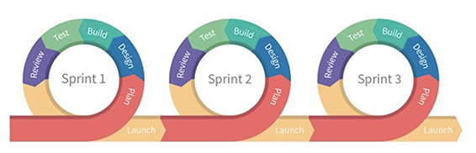
Testing in Agile and Scrum environment

Slide 10
Agile testing principles within Agile manifesto
Individuals and interactions over processes and tools Working software over comprehensive documentation Customer collaboration over contract negotiation Responding to change over following a plan
That is, while there is value in the items on the right, we value the items on the left more.
Everyone is responsible for Quality

Slide 11
Agile testing principles
Provide continuous feedback. Agile testers do not simply test constantly. They are also responsible for distributing the results of those tests and facilitating the provision of feedback from customers to developers in order to create a more robust product.
Deliver value to the customer. While this is the second principle, it is the paramount principle. The end goal of every action taken by an Agile tester is to create the best product possible for the customer.
Enable face-to-face communication. The Agile tester's role is to reduce confusion and errors by communicating directly with developers, as well as enabling customers to communicate directly with developers.
Have courage. Developers can be defensive about their work. To meet their goal of providing value to the customer, Agile testers must fight for the changes and fixes that need to be made.
Keep it simple. Agile testers act on the aphorism that simplicity is the ultimate sophistication. For testing, that means performing only those tests that are necessary, and all tests that are necessary. For the product, that means delivering the simplest possible product that delivers the most possible value.
Practice continuous improvement. Agile testers are keen learners; they are never done learning how to do their job better.
Respond to change. Agile testers are adaptable and flexible, keeping up feedback from user stories, as well as changes in the product and the marketplace.
Self-organise. Instead of waiting at an assigned seat on the assembly line, Agile testers spring into action at every point in the process. They actively seek out problems and bring people together to solve them.
Focus on people. Agile testers are collaborative, preferring human interaction to technology. Their focus on people enables them to deliver a product that prioritises usability and utility.

Slide 12
Testing or Quality Assurance?
Quality assurance:
To create and later to improve all quality
related processes
Quality control:
To evaluate quality, and assess if product already
meets clients wanted quality level
Testing:
To find product defects

Slide 13
What is additionally involved in Quality?
Are we building the application RIGHT?
HOW
Are we building the RIGHT application?
WHAT

Slide 14
Testing activities in Agile team
Preparation
Execution
Exit criteria
Regressions

Slide 15

Work in project from next week

Slide 16

Planning your testing / QA strategy

Slide 17

Do we need planning and Strategy in Agile environment?

Slide 18

Zero defects mindset
Collaboration, communication in team
Agreements in team
Accept – defects will happen, but what is important – how we will react to it

Slide 19

Planning for tests automation

Slide 20

Testing types, levels & techniques

Slide 21
Testing types
Functional testing:
Requirement-based testing
Business-process-based testing
Performance testing
Compatibility testing
Security testing
Scalability testing
Volume testing
Stress testing
Recovery testing
Internationalization testing
Localization testing
Other types:
Confirmation testing
Regression testing
Non-functional testing:
Reliability testing
Usability testing
Efficiency testing
Maintainability testing
Portability testing
Baseline testing
Compliance testing
Accessibility testing
Endurance testing
Load testing

Slide 22
Positive and Negative Testing
Does the app work as expected
Can it handle invalid input or unexpected user behavior

Slide 23
Functional Testing
Tests the processes
Tests WHAT the system does

Slide 24
Non-Functional Testing
Tests the behavioural aspects of the system
Tests HOW the system works

Slide 25
Which testing types are we using?
Functional testing:
Requirement-based testing
Business-process-based testing
Performance testing
Compatibility testing
Security testing
Scalability testing
Volume testing
Stress testing
Recovery testing
Internationalization testing
Localization testing
Other types:
Confirmation testing
Regression testing
Non-functional testing:
Reliability testing
Usability testing
Efficiency testing
Maintainability testing
Portability testing
Baseline testing
Compliance testing
Accessibility testing
Endurance testing
Load testing

Slide 26
Testing levels
Requirements Specification
Acceptance Tests
Acceptance Testing
Functional Specification
System Tests
System
Testing
Technical Specification
Integration Tests
Integration
Testing
Unit Tests
Program Specification
Component Testing
Coding

Slide 27
Testing Design techniques
White Box Techniques:
Statement coverage
Decision coverage
Condition testing
Multi condition testing
Modified condition coverage
Specification based testing (Black box) techniques:
Equivalence partitioning
Boundary value analysis
Decision table testing
State transition testing
Use case testing
Experience based testing

Slide 28

How to choose?

Slide 29

Monkey testing and/or breaking stuff

Slide 30

Why “Monkey testing” or “Breaking stuff” techniques are not enough? Think about requirements and time efficiency

Slide 31
Testing Design techniques
White Box Techniques:
Statement coverage
Decision coverage
Condition testing
Multi condition testing
Modified condition coverage
Specification based testing (Black box) techniques:
Equivalence partitioning
Boundary value analysis
Decision table testing
State transition testing
Use case testing
Experience based testing
Notes:
Bendram žinojimui

Slide 32
Testing levels
Requirements Specification
Acceptance Tests
Acceptance Testing
Functional Specification
System Tests
System
Testing
Technical Specification
Integration Tests
Integration
Testing
Unit Tests
Program Specification
Component Testing
Coding

Slide 33
Testing types
Functional testing:
Requirement-based testing
Business-process-based testing
Performance testing
Compatibility testing
Security testing
Scalability testing
Volume testing
Stress testing
Recovery testing
Internationalization testing
Localization testing
Other types:
Confirmation testing
Regression testing
Non-functional testing:
Reliability testing
Usability testing
Efficiency testing
Maintainability testing
Portability testing
Baseline testing
Compliance testing
Accessibility testing
Endurance testing
Load testing

Slide 34

How other roles are involved?

Slide 35

QA strategy and planning is done…

Slide 36
Preparation

Slide 37

Preparation
Defects prevention
Test cases / checklist
Test data

Slide 38
Defects detection vs. Defects prevention
Quality of requirements
Defects prevention:
Individual review;
Three amigos;
Refinements with team;
Etc.
(Static testing)

Slide 39

For Defects prevention – team agreements

Slide 40
Work in project from next week Defects prevention

Slide 41
Test cases / checklist
Use case
Testing scenario
Test script
Test case
Number
Title
Description
Test data
Testing steps
Expected results
Actual result
Status
…
Testing checklist

Slide 42
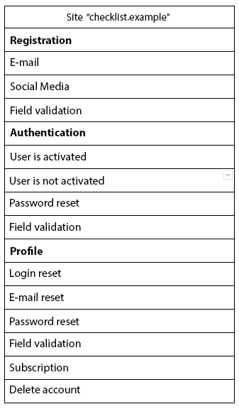
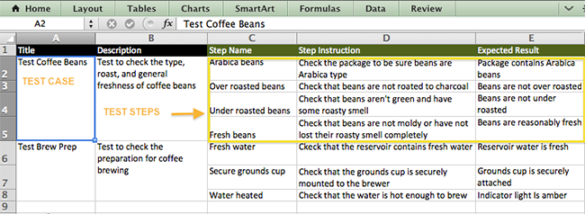
Which to choose? - for testing in sprint - for regression testing

Slide 43
Test data
SPEED and COST: Time to prepare and maintain test data
QUALITY: Complete, controlled, conditioned test data
SECURITY: Total assurance of data privacy
SIMPLICITY: Easy self-service access and preparation

Slide 44

How other roles are involved?
Defects prevention – a lot
Test cases / Test data – (hopefully) little to non

Slide 45
What do we have?
QA strategy
Testing types and levels
Defects prevention for requirements quality
Testing checklist
Test data

Slide 46

Tests execution

Slide 47

Bugs

Slide 48


Slide 49
Kahoot

